Slide 1

Student mark prediction
Basil Narakodan S3 MCA CET

Slide 2
Introduction
●
Our project aims to find students academic performance and find out whether there is any general pattern in their marks and performance.
●
Research on student’s performance prediction have been studied from various attribute in students environment like:
–
Students behaviour Demographics
Students information, psychological and socio-economic
–
–

Slide 3
Objective
●
Main objective of this study is to compare and find the best classification algorithm.

Slide 4
Literature review
●
A Predictive Analytics Model for Students Grade Prediction by Supervised Machine Learning.February 2021IOP Conference Series Materials Science and Engineering 1051(1):012005,DOI:10.1088/1757-899X/1051/1/012005
aims to presents a predictive analytics model using supervised machine learning methods that predicts the student’s final grade (FG) based on their historical academic performance of studies. The work utilized dataset gathered from 489 students. We carried out the experiments using Decision Tree (J48), Random Forest (RF), Support Vector Machines (SVM), and Logistic Regression (LR) to study the comparison performance for both classification and regression techniques in predicting students FG. The findings from the results present that J48 was the best predictive analytics model with the highest prediction accuracy rate of 99.6% that could contribute to the early detection of students’ dropout so that educators can remain the outstanding achievement in higher education.

Slide 5
Dataset
●
Dataset: student alcohol consuption Source:
https://www.kaggle.com/datasets/uciml/student-alcohol-consumption
Survey of students for math course for in a secondary school 396 students observations based on 33 attributes
Algorithm: Linear Regression, Multilayer Perceptron
●
●
●
●

Slide 6
Modules
●
Data insertion
The value for each attribute is captured from the user for predicting the final score.
●
Linear Regression Object
The linear regression object is built by passing the training set(sample data) containing record of a certain no. of students whose performance is to be analyzed by taking consideration attributes.

Slide 7
Data cleaning and Preprocessing
●
Data cleaning is the step where the noise and irrelevent data are removed from the large data set.
●
This is very important step because our outcome would be dependent on the quality of the selected data.
●
Remove duplicate records,enter logically correct values for missing records,remove unnecessary data fields and standardize data format.

Slide 8
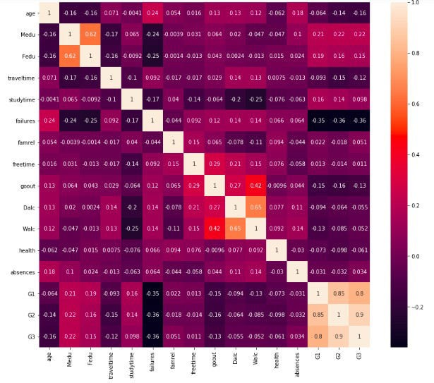
Correlation matrix

Slide 9
Selected attributes
●
Many attributes like Dalc, Walc dont play an important role in determining the student grade
Failure, sex, age, absences, parents education, parents job are statistically significant.
●

Slide 10
Thank You

